Slide 1
ATMTN
An overview of the DevOps project.

Slide 2
Dharam Godhaniya

Slide 3
Bamboo

Slide 4
Zabbix

Slide 5
Alastair Livingstone

Slide 6
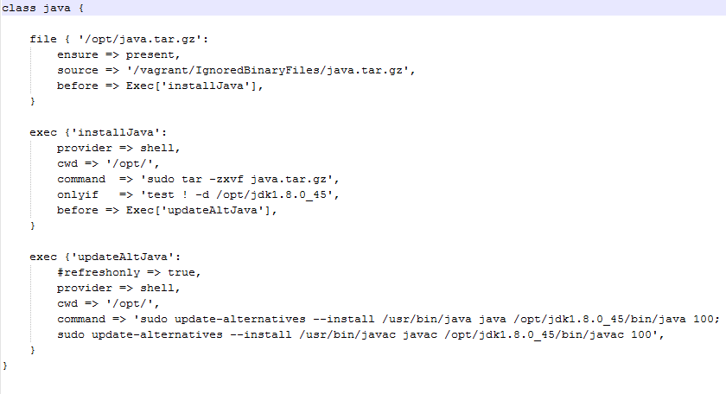
Java Module

Slide 7
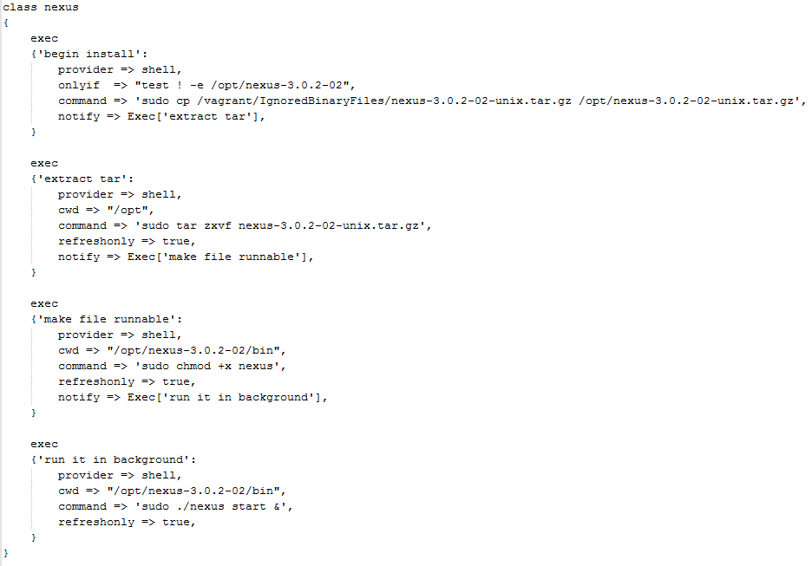
Nexus

Slide 8
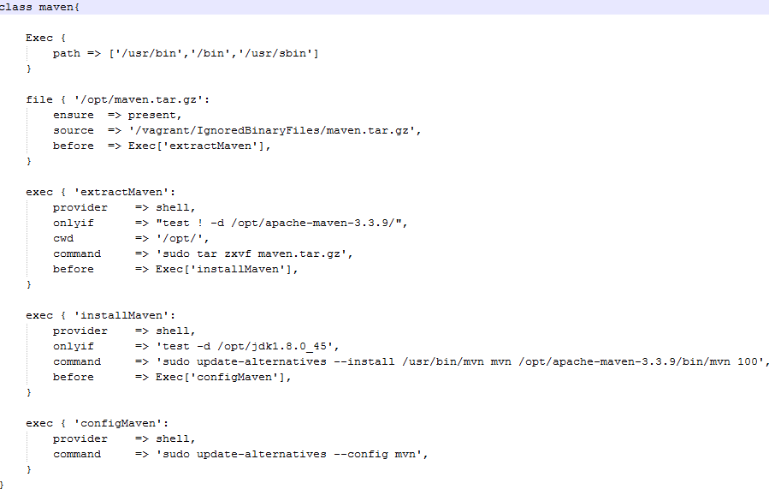
Maven

Slide 9
Alex Mulkerrin

Slide 10
Puppet Master

Slide 11
Jira

Slide 12
Jenkins

Slide 13
Tim Goodwin

Slide 14
Git

Slide 15
MySQL

Slide 16
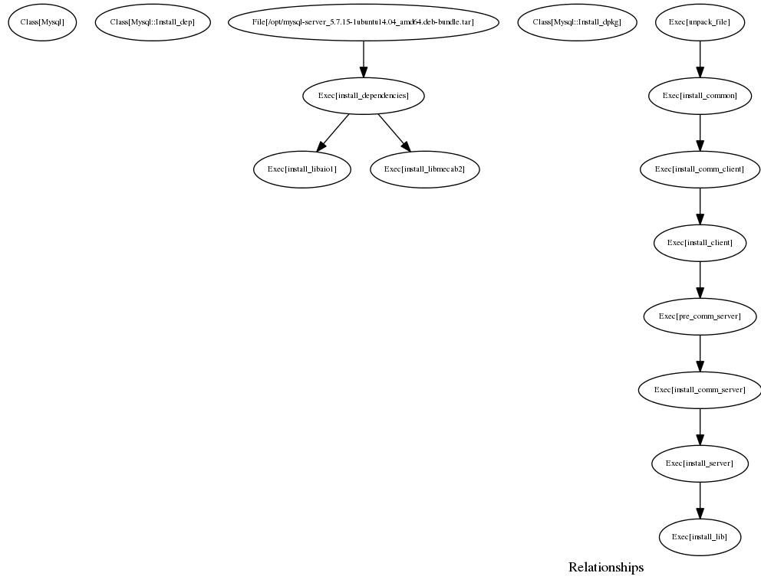

Slide 17
Will - RIP

